Slide 1
PROJECT TITLE – Corporate Social Resposibility Portal
PIP104 University Project-II
Final Review
ROLL NUMBER | STUDENT NAME
20201CCS0065 | Bhuvana V
20201CCS0061 | Rohith M
20201CCS0139 | Saba M
Under the Supervision of
Dr.G Vennira Selvi
Professor
School of Computer Science & Engineering
Presidency University

Slide 2
Abstract
This journal delves into the realm of Corporate Social Responsibility (CSR) to unravel the common practices adopted by corporations across diverse Industries. The study employs a comprehensive approach, drawing insights from a wide range of sources, including academic literature, case studies, and real world examples. The primary objective is to identify the recurring patterns and strategies employed by companies when engaging in CSR initiatives. The research investigates the motivations behind common CSR practices, exploring whether they stem from ethical considerations, regulatory pressures, or a strategic alignment with business goals. Additionally, the article scrutinizes the impact of these practices on corporate reputation, stakeholder relationships, and overall sustainability.

Slide 3

Introduction
Corporate Social Responsibility (CSR) is integral to modern organizations, but limitations in resources and budgets often hinder the potential for significant societal impact. Insufficient communication and collaboration among diverse CSR stakeholders restrict comprehensive societal benefits. The concept of a Common CSR Portal emerges as a solution, providing a centralized platform for corporate and individual entities to unite, collaborate, and pool resources for purposeful CSR initiatives. The Common CSR Portal aims to bridge gaps between organizations, optimizing coordination and resource allocation. Its primary objective is to amplify the positive impact on society through enhanced collaboration and efficiency in CSR efforts.

Slide 4
Literature Review
Feature Extraction based Online Job Portal:
Job search portals and secure log-ins, underscoring the increasing importance of placements
for both job seekers and recruiters.
Mining Transportation Issues from Patient Portal Messages:
Gathered all patient portal messages from 2019 and choose those that had any mention of transportation. Out of the initial 59 million words, we ultimately obtained 177,658 words.
An Interoperable Open Data Portal for Climate Analysis.:
Climate data portal and CSR platform, enhancing semantic information access and corporate oversight.

Slide 5
Proposed Systems
Development: Create a user-friendly web platform for organizations and individuals to list their CSR projects, resources, and areas of expertise.
Resource Matching: Implement algorithms to connect organizations with compatible projects based on resources and expertise.
Knowledge Sharing: Enable stakeholders to share best practices and research findings.
Monitoring and Evaluation: Include tools for project monitoring and reporting impact.
Awareness and Outreach: Promote the portal through marketing, webinars, and partnerships.
Data Security: Ensure data security and privacy compliance.
Impact Measurement: Evaluate the portal's effectiveness using key metrics.

Slide 6
System and Hardware Requirements
Modules
1.Backend
2.Front end
3.Data base
4.Association between different companies
Hardware and software details -
1. Figma
2. Python
3. Node JS
4. Django
5. MySQL

Slide 7
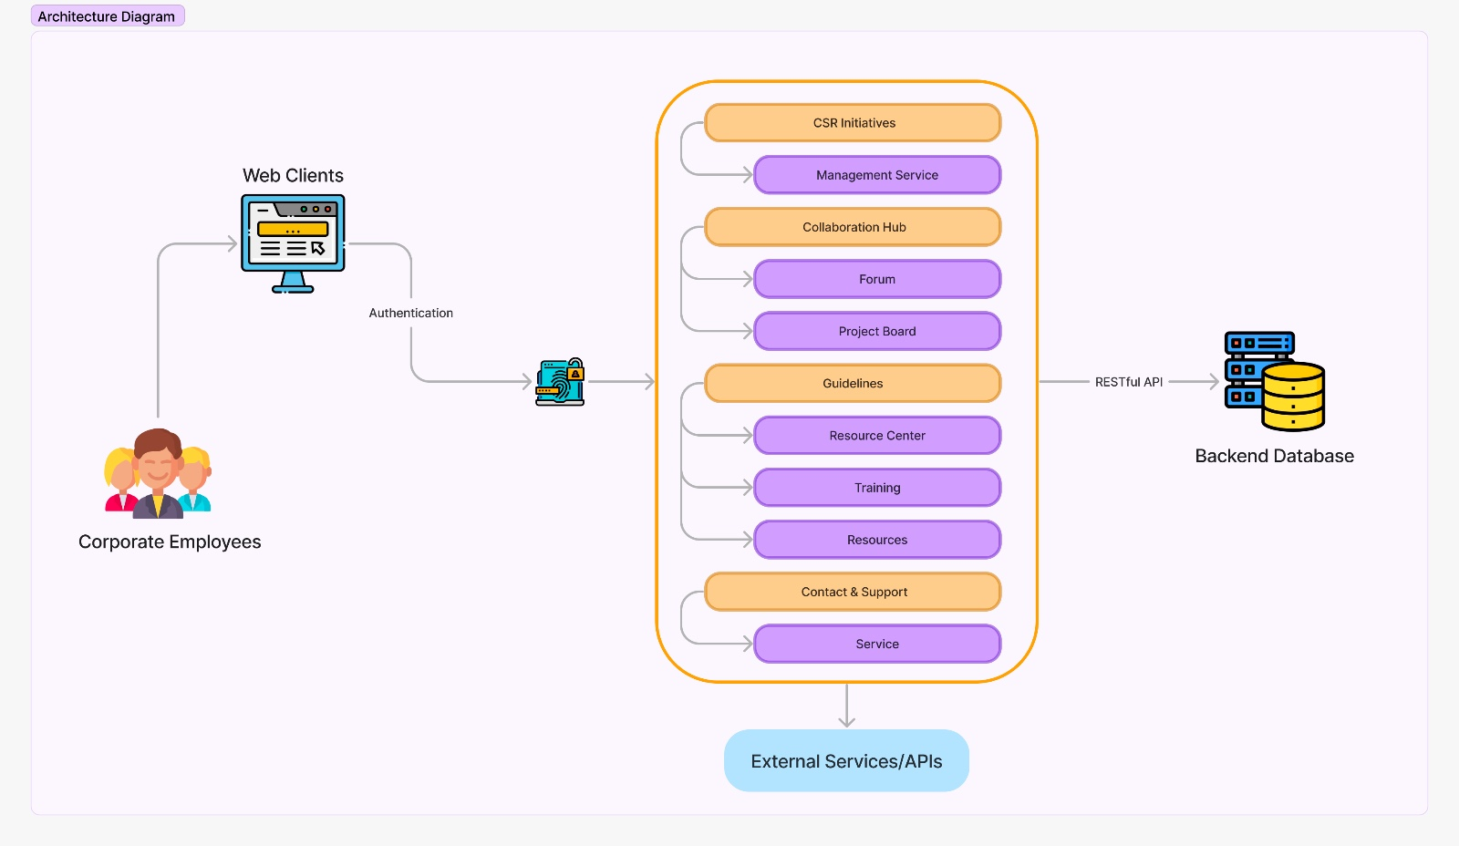
Unified Modelling Language (UML) Diagrams
System Architecture

Slide 8
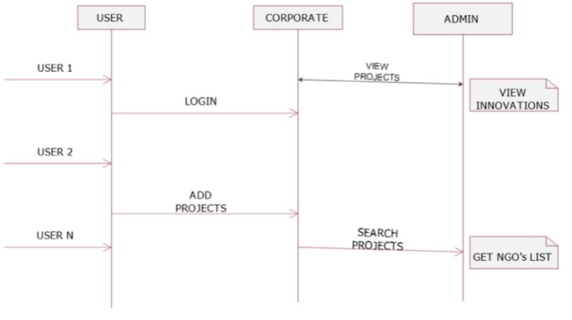
Sequence Diagram

Slide 9
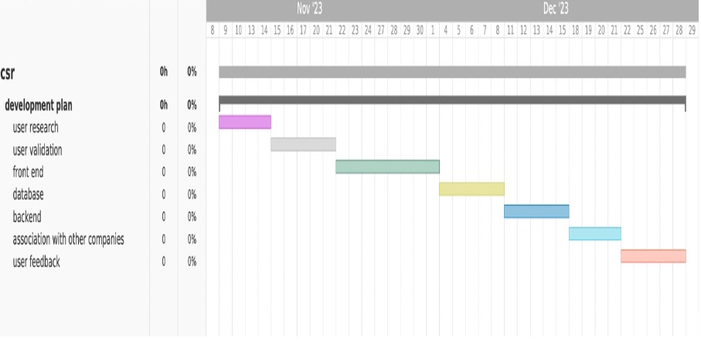
Project Timeline - Gantt Chart

Slide 10
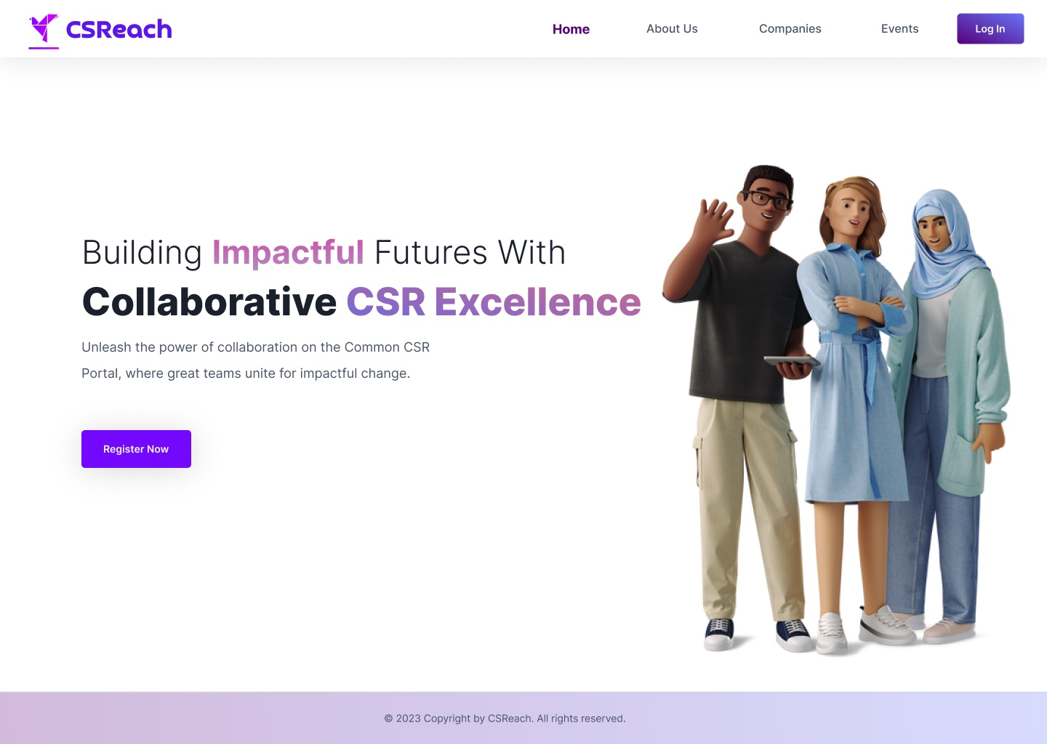
Result Snippet

Slide 11
Conclusion
In this plan to create the Common CSR Portal, we emphasize efficiency and user - centered design for a streamlined development process. We are committed to building a platform that fosters collaboration, efficient resource allocation, knowledge sharing, and user-friendly experiences.
Users actively participating in CSR initiatives through the app demonstrate its effectiveness in mobilizing corporate social responsibility efforts. The app serves as a conduit for channeling collective energy towards meaningful societal impact, showcasing the power of technology to unite businesses, employees, and communities in a shared commitment to social responsibility.

Slide 12

Future Scopes
Advanced Collaboration Features
Real-Time Impact Tracking
Technology Integration
User-Friendly Interface
Global Reach

Slide 13

References
George Serafeim, Beiting Cheng, Ioannis Ioannou":Corporate Social Responsibility and Access to Finance, Published in: Strategic Management Journal, 2021.This article discusses the relationship between corporate social responsibility (CSR) practices and access to finance \
Carroll's Pyramid of CSR 1999
Matten, D. and Moon, J. (2008) “Implicit” and “Explicit” CSR: A Conceptual Framework for a Comparative Understanding of Corporate Social Responsibility
Austin J.E., Leonard H., Reficco E., & Wei–Skillern J. (2004). Corporate social entrepreneurship: A new vision of CSR. Harvard Business School Working Paper No.

Slide 14


